Slide 1



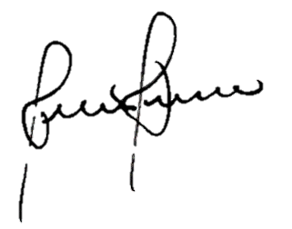
SATHYABAMA INSTITUTE OF SCIENCE AND TECHNOLOGY
ADVAYA FEST 2018
MERIT CERTIFICATE
This is to certify that Mr/Ms ..........................................................
Of ………................................................................... college
has secured ……..... place in PAPER PRESENATION
on.17TH&18TH FEB 2018
H.O.D PRINCIPAL

Slide 2
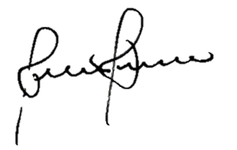
SATHYABAMA INSTITUTE OF SCIENCE
AND TECHNOLOGY
ADVAYA FEST 2018
Certificate of Participation
This is to certify that Mr/Ms ..........................................................
Of ………................................................................... college has
participated in the Event of “PAPER PRESENTATION”
on 17TH&18H FEB 2018.
H.O.D PRINCIPAL

Slide 3


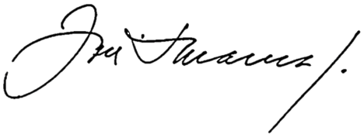
RAJALAKSHMI ENGINEERING COLLEGE
TECHNOSTAV 2018
MERIT CERTIFICATE
This is to certify that Mr/Ms ..........................................................
Of ………................................................................... College
has secured ………… place in “ POSTER PRESENTATION”
on 02rd February 2018.
H.O.D PRINCIPAL

Slide 4


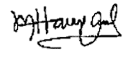
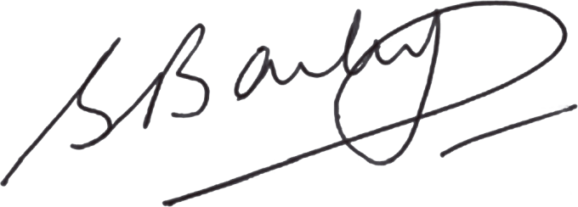
HINDUSTAN INSTITUTE OF TECHNOLOGY AND SCIENCE
CRR TECH FEST 2018
Certificate of PARTICIPATION
This is to certify that Mr/Ms ......................................................
Of..................................................................college has
participated in the Event of “C - QUIZ”
on 10THMAY 2018.
H.O.D PRINCIPAL

Slide 5


ANNA UNIVERSITY,CHENNAI
TECHNOPHILIA FEST 2019
Certificate of PARTICIPATION
This is to certify that Mr/Ms ......................................................
Of..................................................................college has
participated in the Event of “NEO TECH”
on 21TH MARCH 2019.
H.O.D PRINCIPAL

Slide 6


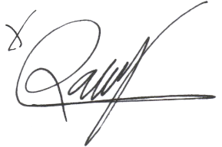
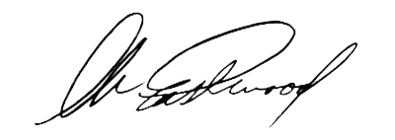
SRI SAI RAM ENGINEERING COLLEGE , CHENNAI
TECHNOZARRE FEST 2019
Certificate of Participation
This is to certify that Mr/Ms ......................................................
Of .….................................................................. college has
Participated in the Event of “TECH GEEKS”
On 16th June 2019.
H.O.D PRINCIPAL

